Slide 1

ATM Management System
Created By: Vivek Yadav

Slide 2
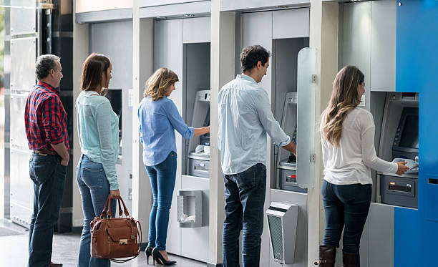
Introduction Objective: Streamlining ATM operations by enabling users to perform essential banking functions efficiently. Developed in Python with a graphical user interface (GUI) for an intuitive user experience. Key Features: Secure login system with PIN verification for multiple users. Supports essential ATM functionalities: Check Balance: View the available account balance. Withdraw Money: Safely withdraw cash with balance validation. Transfer Money: Send funds to other registered accounts. User-friendly interface with categorized operations for easy navigation.

Slide 3

Objectives and Scope Objectives: The objective is to develop a user-friendly ATM management system for secure and efficient banking tasks. It includes PIN-protected login and supports key transactions like balance inquiries, withdrawals, and fund transfers. Designed for simplicity and scalability, the system suits small- to medium-sized banking operations or self-service kiosks. Scope: The system is compatible with minimal hardware, ensuring easy integration. Future enhancements include database integration, an improved GUI, and advanced security features like two-factor authentication for greater usability and safety.

Slide 4

Application Tools Programming Language: Python Simple, versatile, and supports required functionalities. IDEs: PyCharm: Debugging and code management. Visual Studio Code: Lightweight and extension support. Libraries: Tkinter: User-friendly GUI. OS Module: File handling (vehicle data storage). Additional Tools: Lucidchart: Flowchart creation. MS Word: Documentation and report creation.

Slide 5

Project Design Data Storage: The system uses Python dictionaries for storing user data, including ATM card numbers, PINs, account balances, and transaction details. Core Functions: Secure Login: Validates ATM card number and PIN to grant user access. Check Balance: Displays the user's available account balance. Withdraw Money: Processes withdrawal requests, ensuring sufficient funds before updating the balance. Transfer Money: Facilitates fund transfers by verifying recipient account details and available balance. Modular Design: Each function operates independently, promoting ease of debugging, maintenance, and scalability.

Slide 6
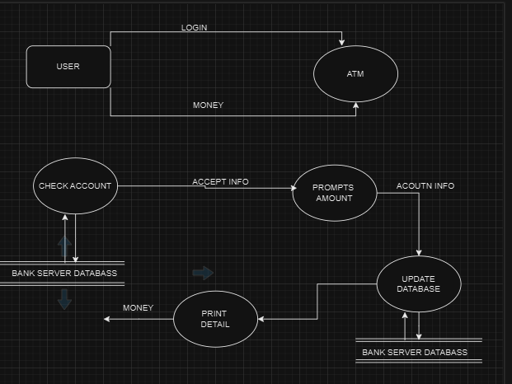
Main Operations Flow:
Login and Authentication:
User enters ATM card number and PIN for secure access.
Transaction Menu:
Check Balance: Displays available account balance.
Withdraw Money: User inputs the amount, which is validated against the balance before updating.
Transfer Money: User provides recipient account and amount; the system verifies details and updates balances accordingly.
Logout:
Ensures session security by closing the transaction window after each operation..

Slide 7
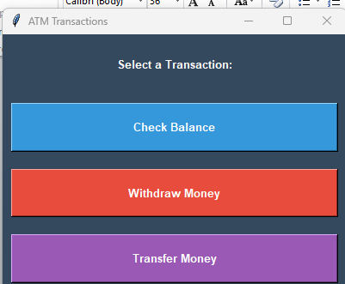
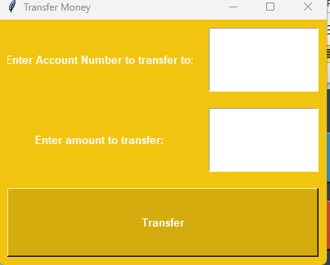
Testing and Validation
Testing Methods:
Unit Testing: Each function tested individually for data consistency and performance.
System Testing: Evaluate system performance under maximum load (50 cars and 50 bikes).
Stress Testing: Test system behavior under overload conditions.
Validation:
Accurate data storage and retrieval.
Correct handling of invalid operations.

Slide 8
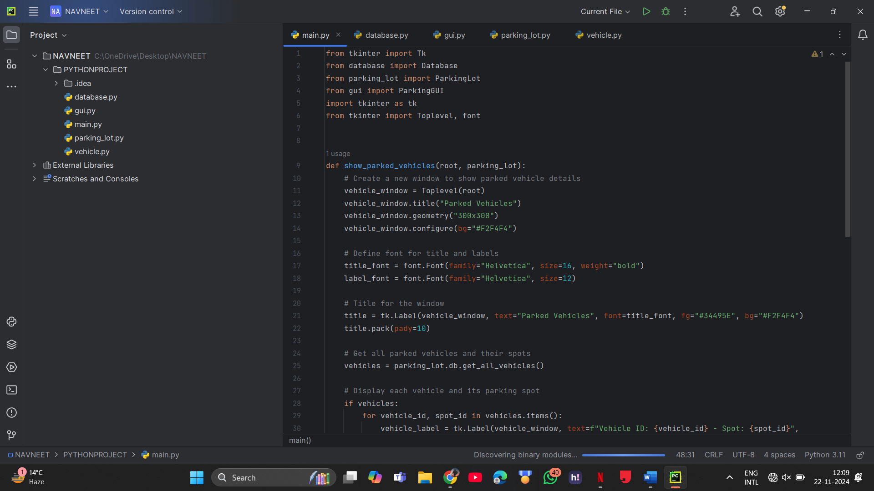
Implementation

Slide 9

Thank You!

